Slide 1
Real Estate Tableau Analysis

Slide 2
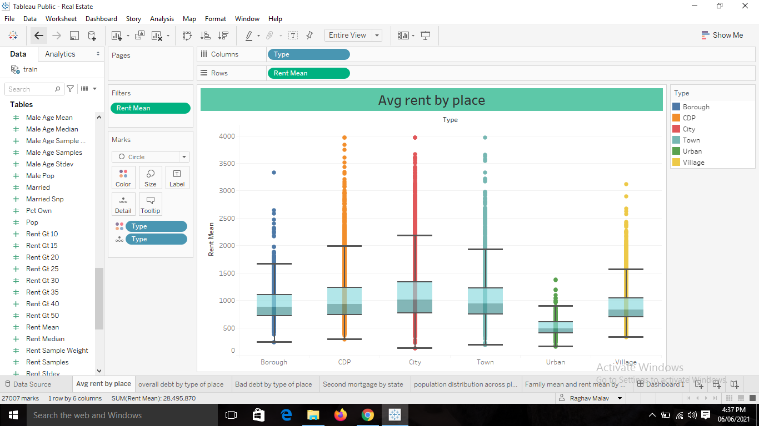
Box Plot

Slide 3
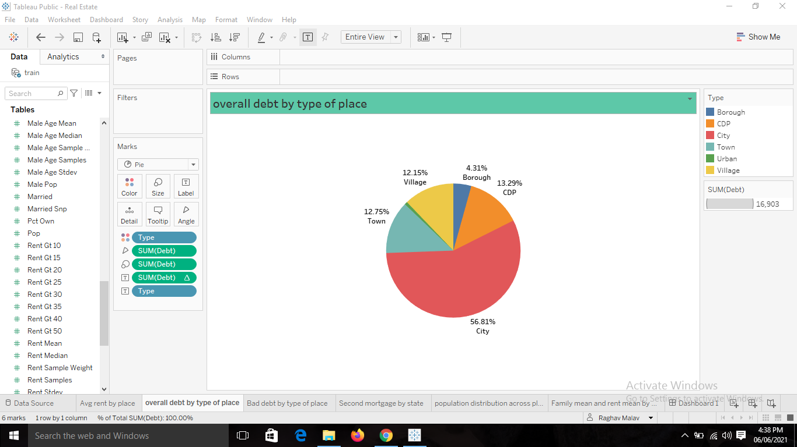
Pie Chart for debt by place

Slide 4
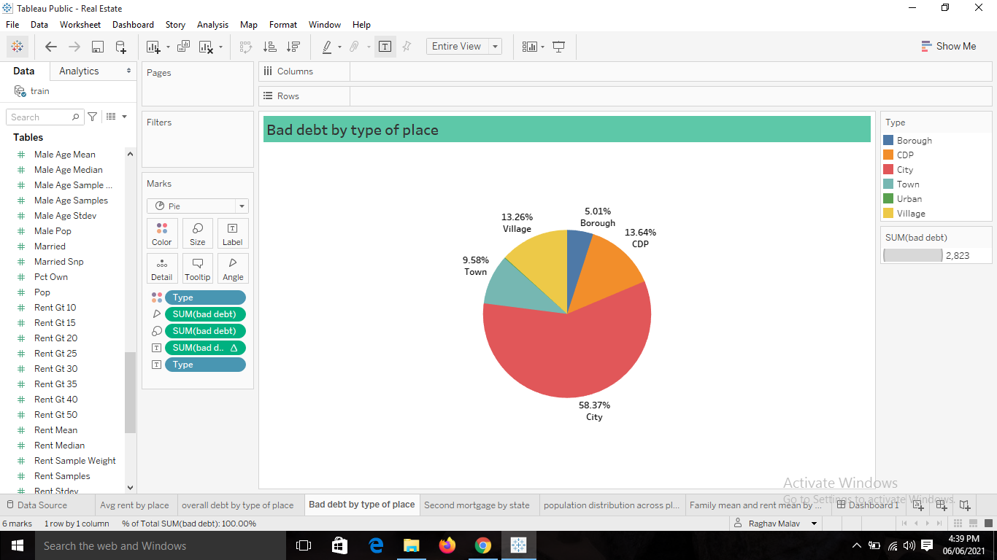
Pie chart for bad debt by place

Slide 5
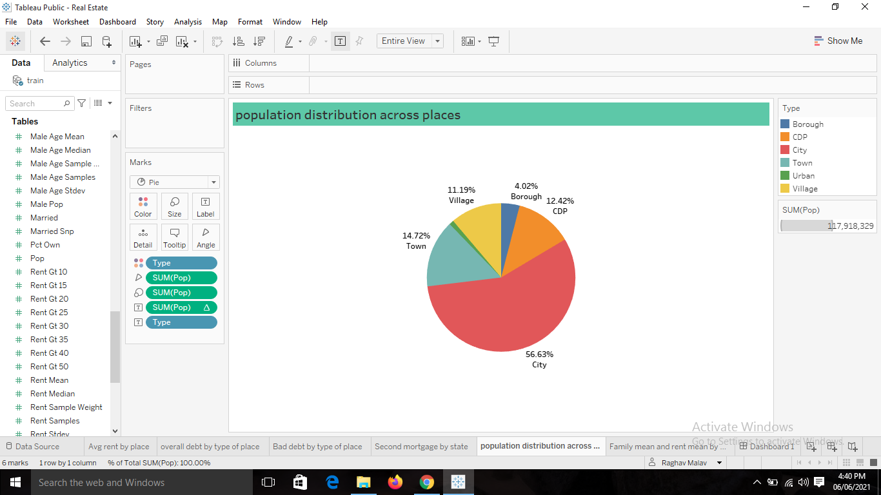
Population distribution across places

Slide 6
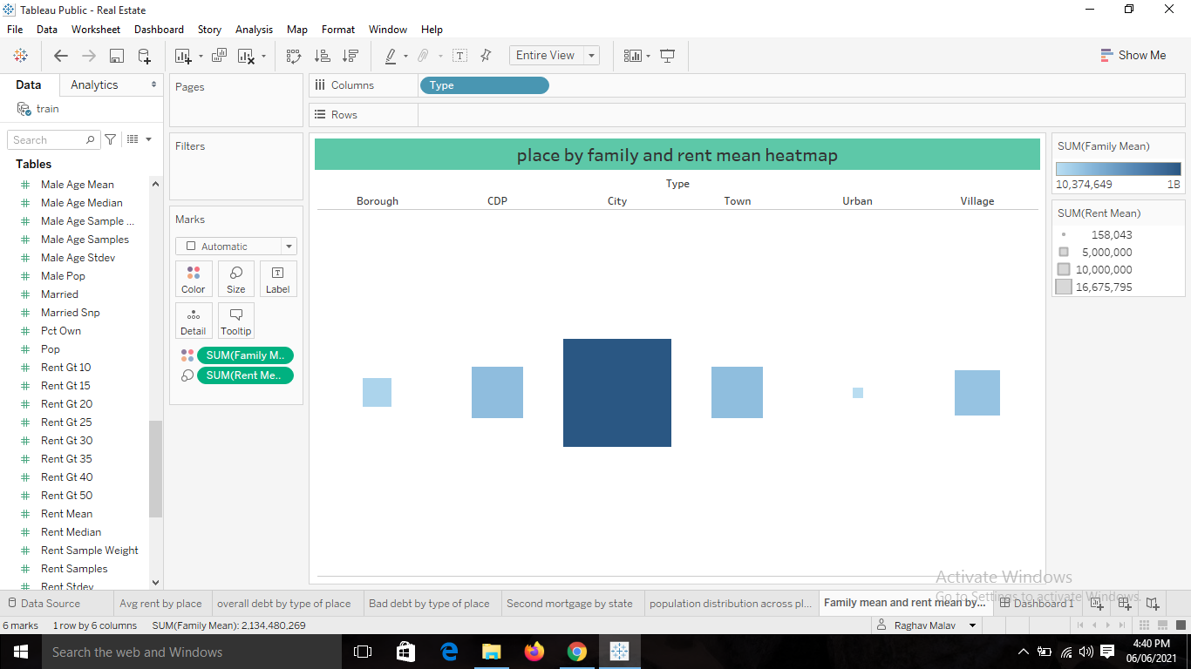
Heat map by places for family and rent mean

Slide 7
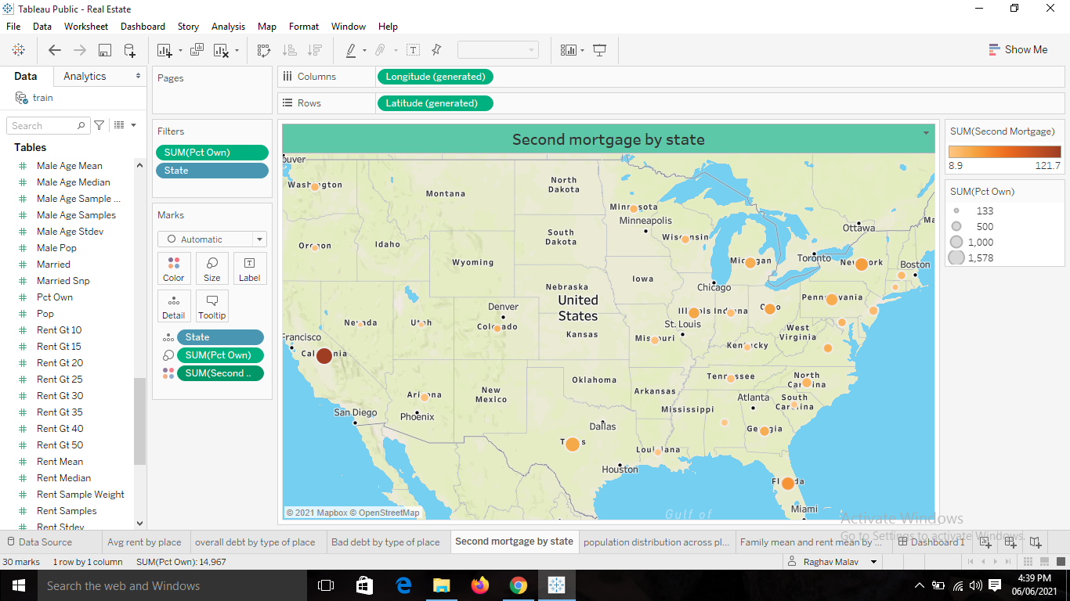
Second mortgage by state

Slide 8
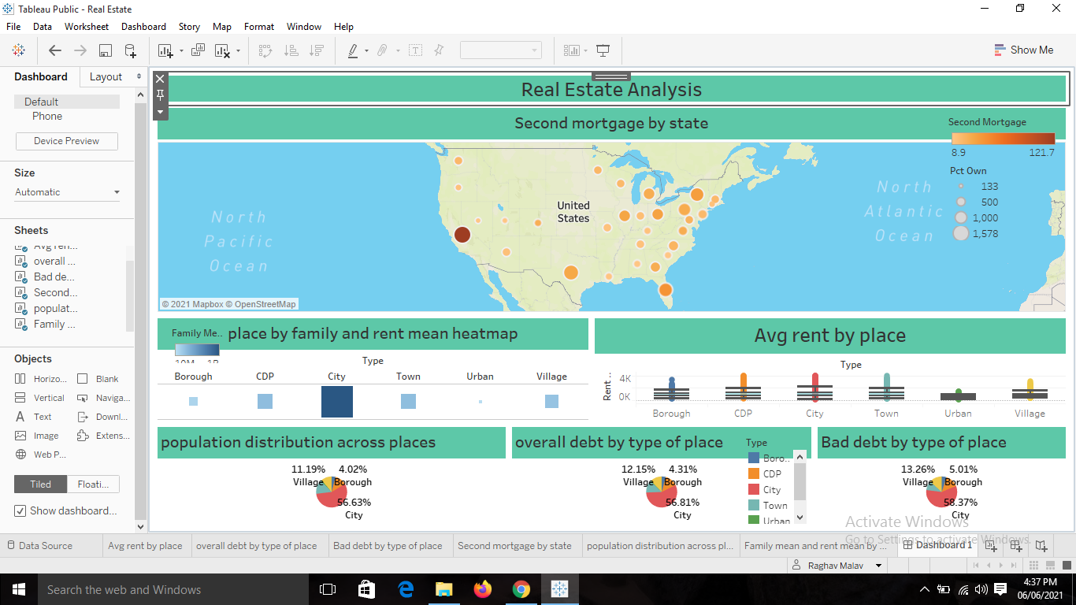
Dashboard pic

